Slide 1
Margin behavior and other properties

Slide 2
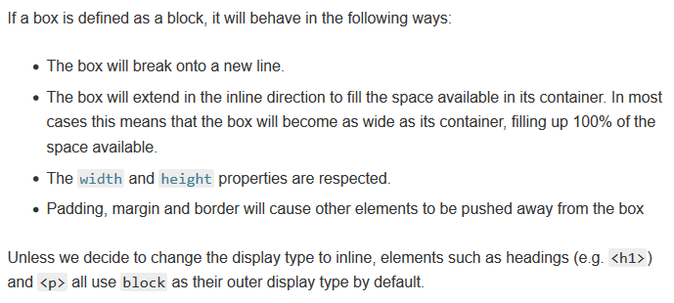
Block elements
Block elements

Slide 3
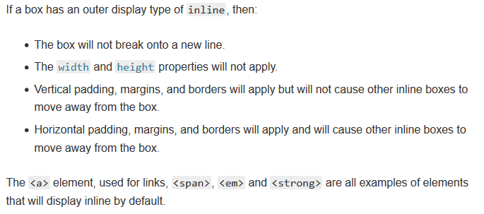
Inline elements
Inline elements

Slide 4
# Introduction to the CSS basic box model
https://developer.mozilla.org/en-US/docs/Web/CSS/CSS_Box_Model/Introduction_to_the_CSS_box_model
https://developer.mozilla.org/en-US/docs/Learn/CSS/Building_blocks/The_box_model
# Niederst Robbins, J., 2018. Learning Web design: a beginner’s guide to HTML, CSS, JavaScript, and web graphics.
Chapter 14
Sources

